Slide 1



Statistical Inferences of Eye movement data using Bayesian smoothing
Junpeng Lao, PhD
Bayes@Lund, 2017-04-20
I am supported by the Swiss National Science Foundation

Slide 2





Little bit about myself…
iBMLab

Slide 3

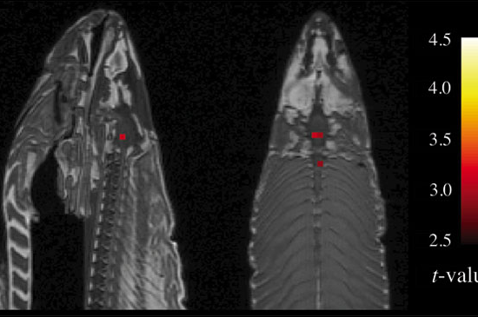
Little bit about myself…
Eye-tracking
EEG
fMRI
https://github.com/junpenglao/
http://junpenglao.xyz

Slide 4
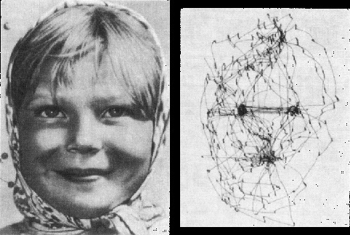
Eye movement
Yarbus, A. L. (1967)
Notes:
Image source:
http://smc.neuralcorrelate.com/research-lines/fixational-eye-movements/

Slide 5
The Question:
flic.kr/p/c1UTf
Notes:
https://flic.kr/p/c1UTf

Slide 6
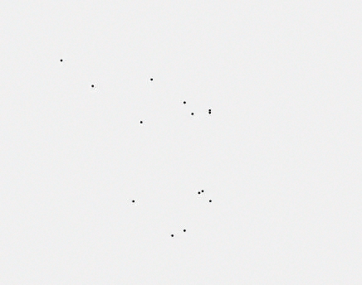
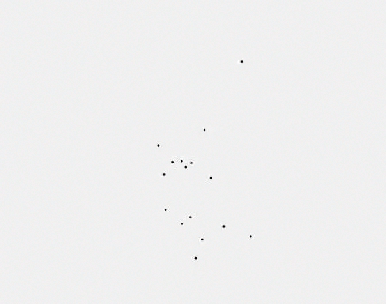
Fixations
Group A
Group B

Slide 7
NHST:
Group A
Group B

Slide 8
Data-driven analysis
Group A
Group B

Slide 9
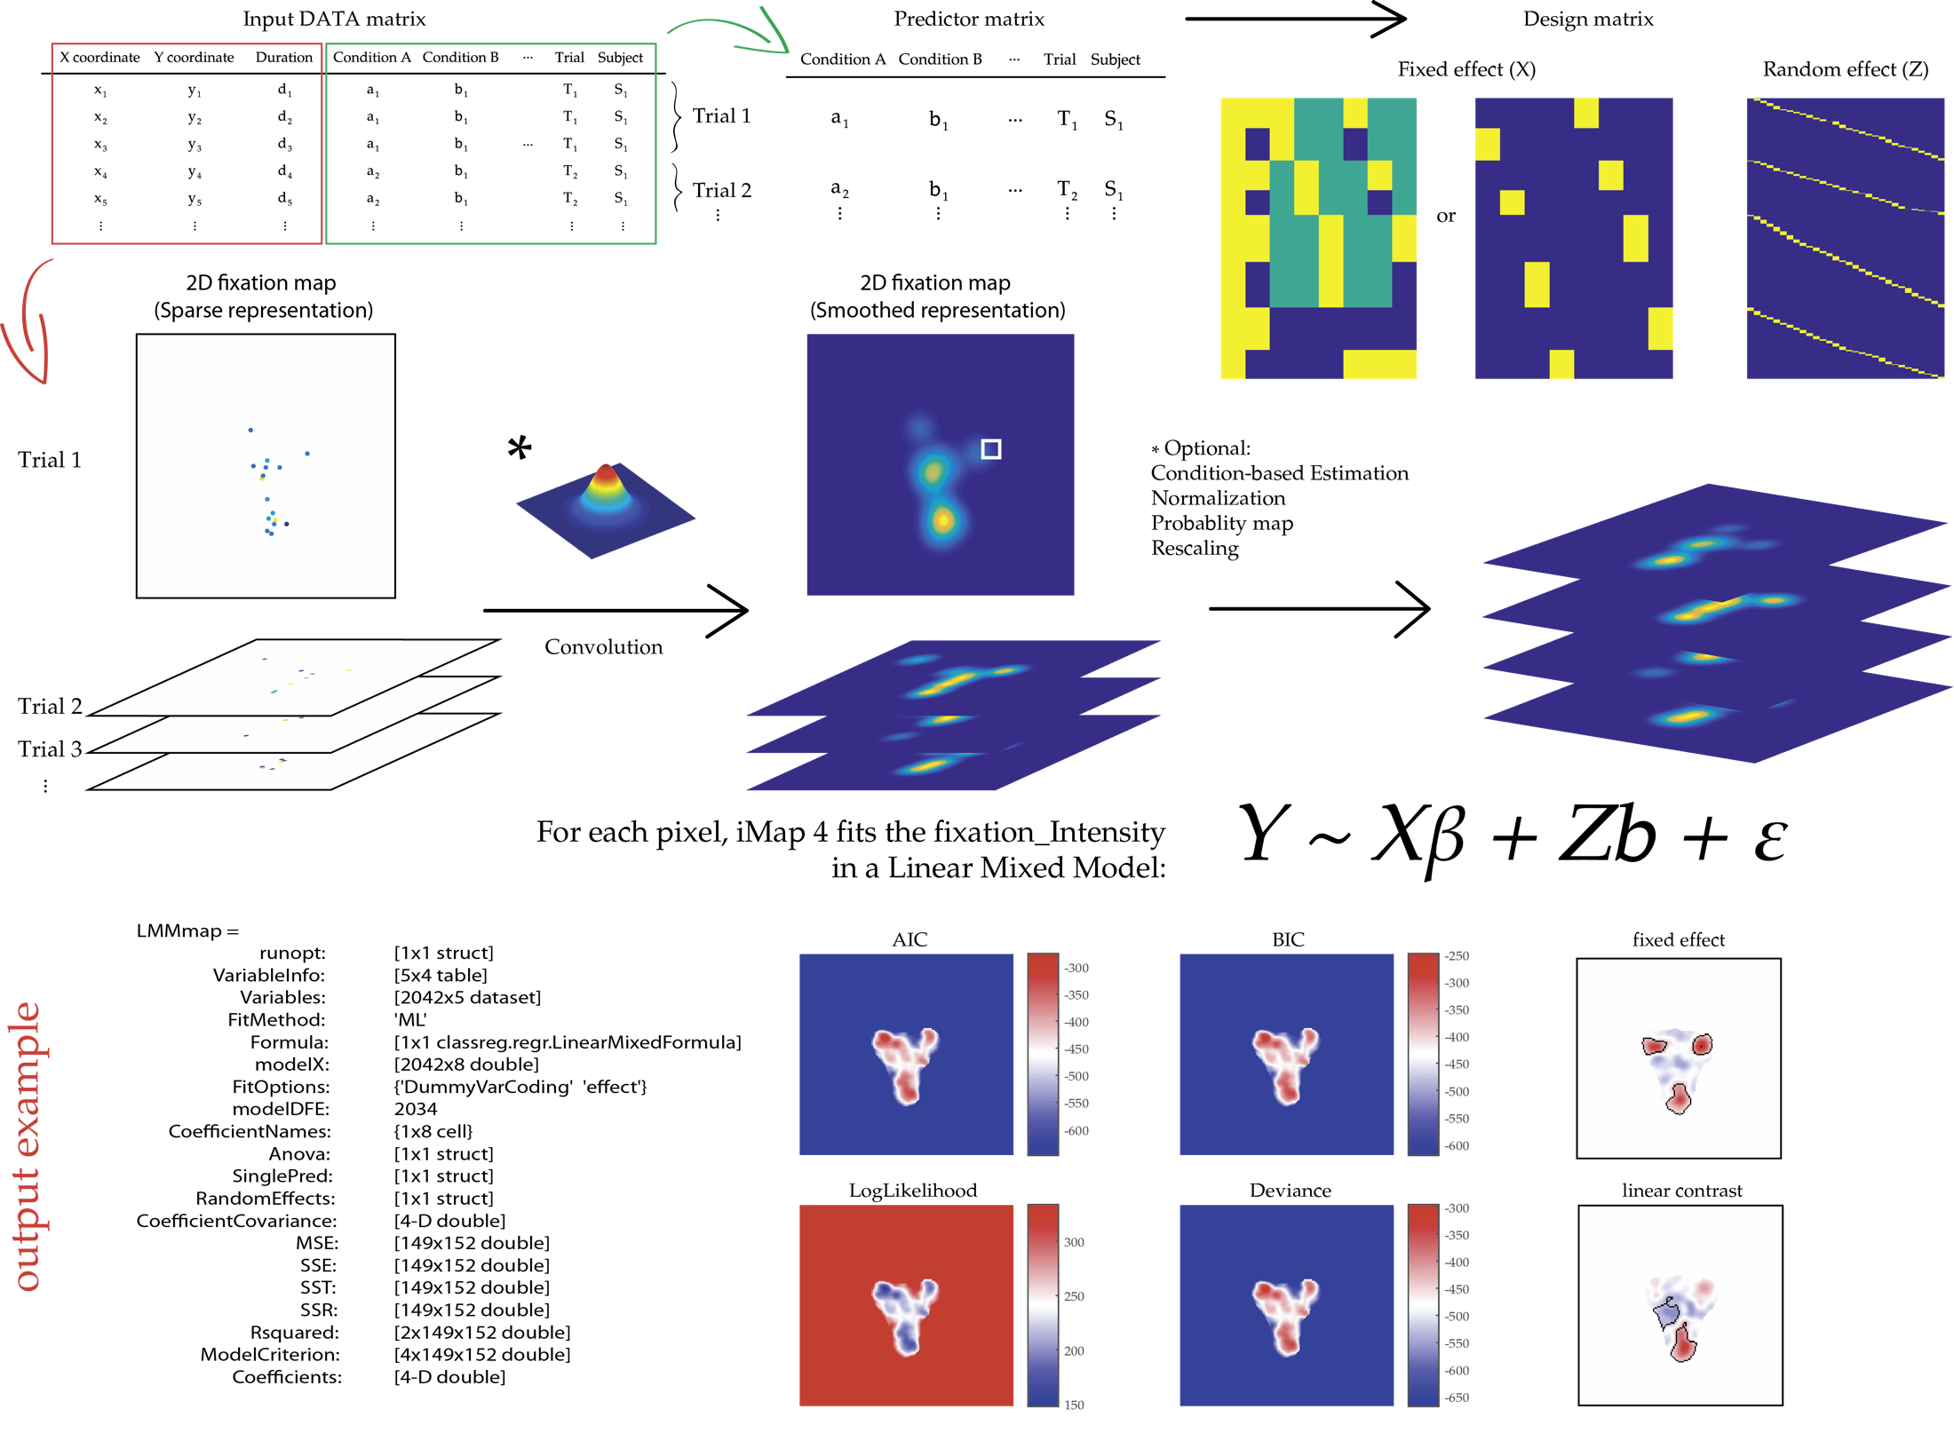
Spatial mapping of fixation data

Slide 11
Thanks!

